Slide 1
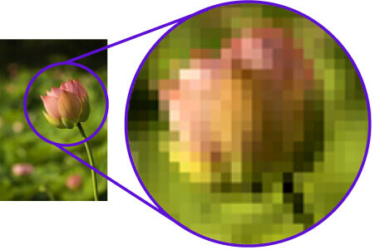
ITA0506-COMPUTER VISION
Title: Technical Analysis of Pixel Representation and Challenges in Pixel-Based Image Processing
PRESENTED BY :
R SUSHMA(192525279)
AI&ML
SSE ENGINEERING
CHENNAI

Slide 2
Pixel Representation
What is a Pixel?
A pixel (Picture Element) is the smallest unit of a digital image.
Images are made up of millions of pixels arranged in a grid.
Each pixel stores intensity or color information.
Types of Pixel Representation
Binary: 0 (black) or 1 (white)
Grayscale: Values from 0–255
RGB Color: Red, Green, and Blue values (0–255 each)
Example RGB Pixel
Visual:
Pixel grid or RGB color model.
Red | Green | Blue
255 | 120 | 60

Slide 3
Pixel-Based Image Processing
How Images are Processed
Image Processing Flow:
Input Image → Pixel Analysis → Processing Algorithm → Output Image
Common Pixel Operations
Image enhancement
Noise reduction
Edge detection
Image segmentation
Image compression
Applications
Medical imaging
Face recognition
Satellite imaging
Autonomous vehicles

Slide 4
Challenges in Pixel-Based Image Processing
Challenge | Description
Noise | Random pixel variations reduce image quality
Blur | Loss of sharp details
Low Resolution | Limited image information
Lighting Variations | Uneven brightness affects analysis
High Processing Cost | Large images require more computation
Solutions
Median filtering
Histogram equalization
Image sharpening
GPU-based processing
Visual:
Comparison of noisy image and filtered image.

Slide 5
Conclusion
Key Takeaways
Pixels are the foundation of digital images.
Pixel representation determines image quality and accuracy.
Image processing improves image interpretation through pixel-level analysis.
Challenges such as noise, blur, and computational cost can be addressed using advanced algorithms.
Conclusion
Effective pixel representation and robust image processing techniques enable accurate analysis in applications such as healthcare, security, remote sensing, and artificial intelligence.
Visual:
A simple infographic summarizing Pixel → Processing → Enhanced Image → Real-World Applications.

Slide 6


